Slide 1
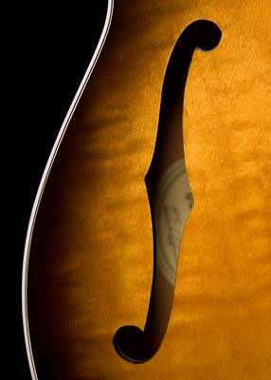
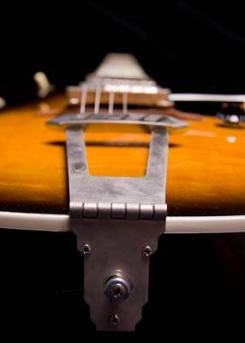
Parts of the
Guitar
in Pictures

Slide 3
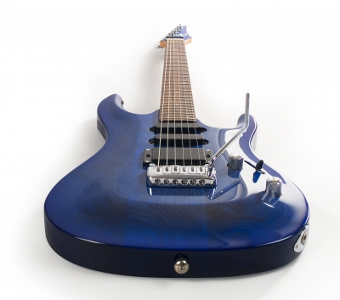
Electric Guitar

Slide 4
Headstock
The headstock is located at the end of the neck and houses the tuning keys. Common arrangements of the tuning keys on the headstock are 3 on each side or all six on one side. Some guitars don't have headstocks.

Slide 5
Tuning Keys
Headstock
The tuning keys are the machine heads that adjust the tension of the strings, allowing the player to change the pitch of the string.

Slide 6
Tuning Keys
Headstock
Nut
The nut is a small strip of medium-hard material (usually bone, plastic, brass, or stainless steel) at the joint where the headstock meets the fretboard. The nut has grooves in it to guide the strings onto the fretboard and it is one of the endpoints of the strings’ vibrating length.

Slide 7
The frets are metal strips located at points on the fretboard that divide it into half-steps of the scale. Classical guitars generally have 19 frets and electric guitars have 21-24 frets, but some guitars have up to 27 frets. We play individual notes and chords using the frets.
Tuning Keys
Fret
Headstock
Nut
Fretboard
The fretboard (also known as the fingerboard) is the piece of wood embedded with metal frets that makes up the top portion of the neck. It is commonly made of wood (rosewood, ebony, maple) or manufactured/composite materials.

Slide 8
Tuning Keys
Fret
Position Marker
Headstock
Nut
Fretboard
Position markers are small visual aids inlaid into the upper edge of the fretboard between frets that are small enough to be visible only to the player. Common shapes are dots, diamonds, parallelograms, or boxes. These can be made of mother of pearl, abalone, ivory, coloured wood or other exotic materials (usually for older or higher-end guitars) or plastic or painted (cheaper guitars).

Slide 9
Tuning Keys
Fret
Position Marker
Headstock
Nut
Neck
Fretboard
The neck is the long wooden extension from the body of the guitar. It contains the fretboard, frets, position markers, nut, headstock, and tuning keys.

Slide 10
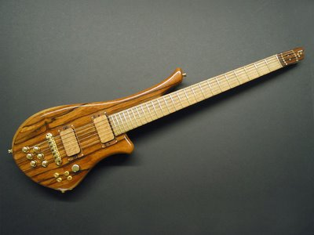
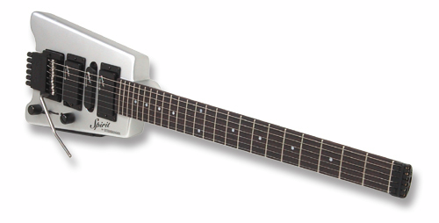

Slide 11
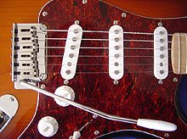
Body
The body of the guitar is other major part of the guitar where the string are attached and sound is produced. There are two types of bodies: hollow (acoustic guitars) and solid (electric). With electric guitars, the body houses the electronics and controls used to create and amplify the sound (pick-ups, volume and tone controls, vibrato bar) as well as contains the bridge, which anchors the strings down. Most electric guitar bodies are made of wood and typically are made of two pieces of wood. The most common woods used for electric guitar body construction include maple, basswood, ash, poplar, alder, and mahogany.

Slide 12
Body
Pick Guard
The pick guard (also known as a scratchplate) is usually a piece of laminated plastic or other material that protects the finish of the top of the guitar from damage due to the use of a plectrum or fingernails. Electric guitars sometimes mount pickups and electronics on the pick guard.

Slide 13
Bridge
Body
Pick Guard
The bridge is where the strings of the instrument are attached to the body of the guitar. On all electric, acoustic and original guitars, the bridge holds the strings in place on the body.

Slide 14
Bridge
Pickups
Body
Pick Guard
Pickup Selector
Pickups are transducers attached to a guitar that detect (or "pick up") string vibrations and convert string vibration to an electric signal, which in turn is amplified and fed to speakers, which vibrate the air to produce the sounds we hear, The most common type of pickup is electromagnetic in design. These contain magnets that are tightly wrapped in a coil, or coils, of copper wire. Such pickups are usually placed right underneath the guitar strings. Pickup selector allows the player to choose what pickup to use.

Slide 15
Bridge
Pickups
Body
Volume Control
Pick Guard
Controls the volume of the guitar
Vibrato Bar
(whammy bar)
Tone Control
Pickup Selector
Controls the tone of the guitar
The vibrato bar (aka the “whammy bar”) is a vibrato and pitch bending device found on electric guitars. By pressing the bar, the player can distort the pitch by bending it down or creating a vibrato effect by frequently pressing it.

Slide 16
Pickups
Body
Bridge
Strings
Volume Control
Pick Guard
Pickup Selector
Vibrato Bar
(whammy Bar)
Tone Control
Guitars have six strings (we'll learn the specific strings later). Modern guitar strings are constructed of metal, polymers, or animal or plant product materials. Instruments utilizing "steel" strings may have strings made of alloys incorporating steel, nickel or phosphor bronze.

Slide 17
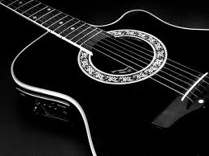
Acoustic Guitar

Slide 18
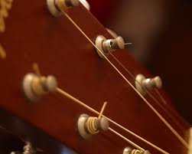

Slide 19
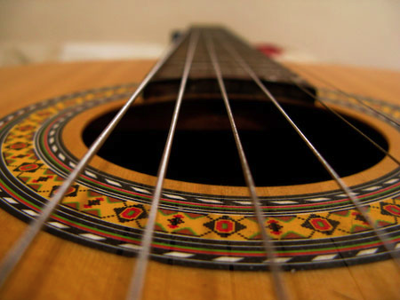
In acoustic guitars, string vibration is transmitted through the bridge and saddle to the body via the sound board. The sound board is typically made of tone woods such as spruce or cedar. Timbers for tone woods are chosen for both strength and ability to transfer mechanical energy from the strings to the air within the guitar body. Sound is further shaped by the characteristics of the guitar body's resonant cavity.

Slide 20
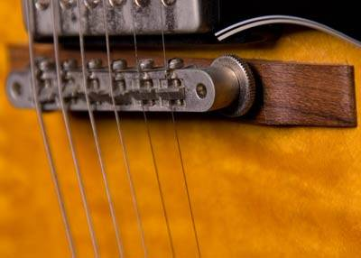
The bridge is where the strings of the instrument are attached to the body of the guitar. On all electric, acoustic and original guitars, the bridge holds the strings in place on the body. On acoustic guitars, the main purpose of the bridge is to transfer the vibration from the strings to the soundboard, which vibrates the air inside of the guitar, thereby amplifying the sound produced by the strings.

Slide 21
Strings
Bridge
Strings

